Slide 1



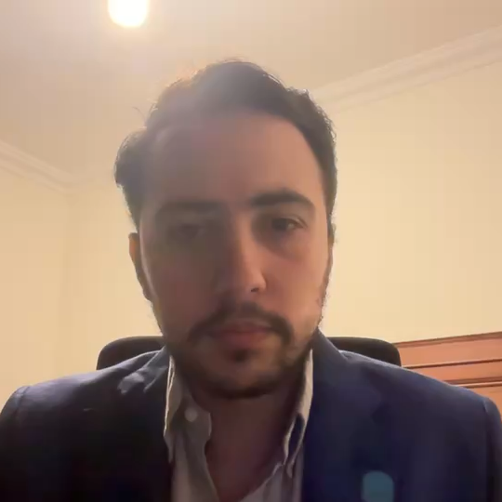
OPTIMIZING TV PROGRAM SCHEDULING
Presented By : Mohammad Knio

Slide 2
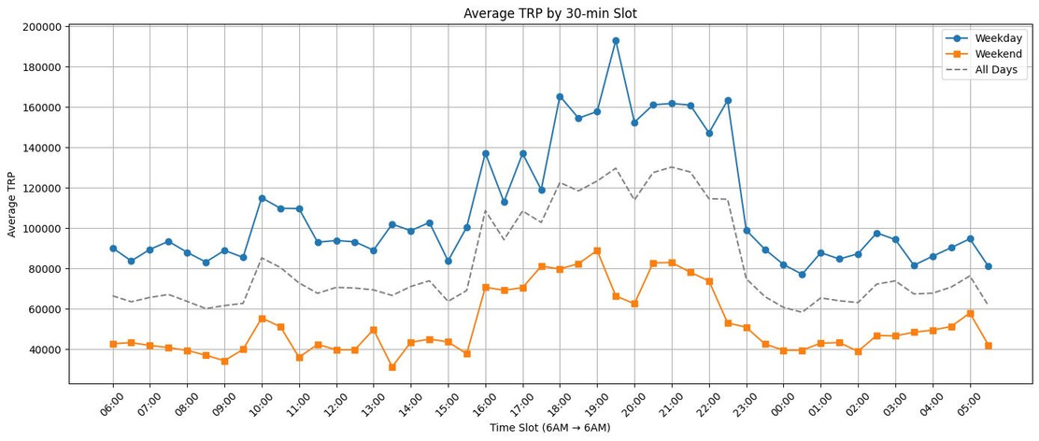
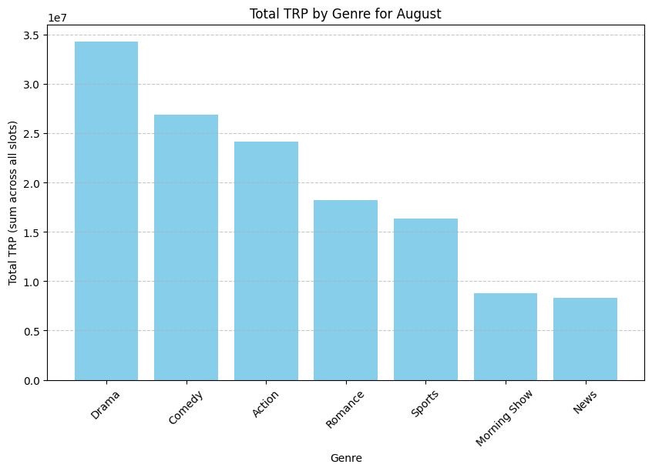
PROBLEM STATEMENT
Place 10 new programs optimally on the weekly TV grid.
Manual scheduling is slow, error-prone, and biased.
Many conflicting constraints: genre spacing, program duration, peak vs off-peak slots.
TRP varies hourly and daily, making manual optimization difficult.
Weekend vs weekday patterns differ.

Slide 3
OBJECTIVES
MAXIMIZE TOTAL TRP FOR THE 10 NEW PROGRAMS
RESPECT CONSTRAINTS:
DURATION RULES (WEEKDAY = 1 HOUR, WEEKEND = 2 HOURS)
GENRE SPACING AVOID SAME-GENRE CONSECUTIVE PROGRAMS)
PEAK-HOUR TRP FOR MAXIMUM VIEWERSHIP
WEEKEND VS WEEKDAY DYNAMICS
01
04
02
PLACE ALL PROGRAMS EXACTLY ONCE ON THE GRID
03
LEVERAGE AI-GENERATED METADATA (SUBGENRE, TONE, VIOLENCE, THEME, AGE GROUP)
PRODUCE A CLEAR, READABLE, OPTIMIZED WEEKLY SCHEDULE
05

Slide 4
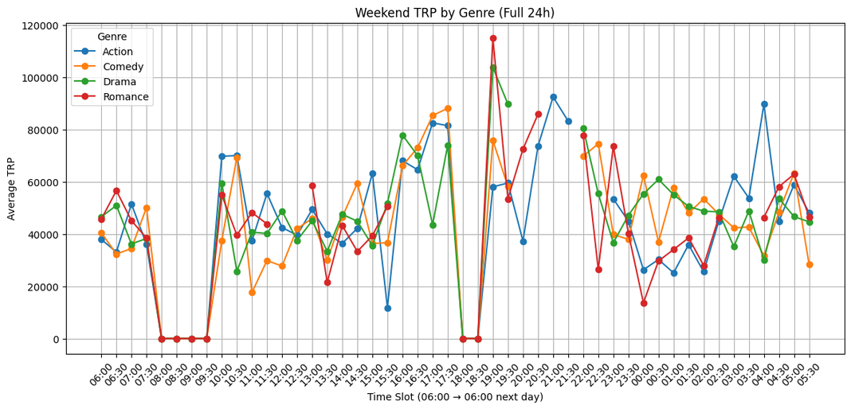

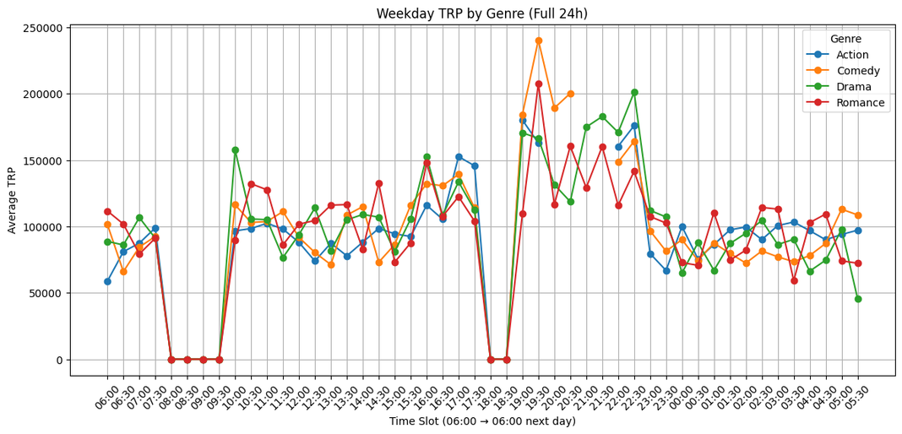
DATA & FEATURE ENGINEERING
KEY ENGINEERED COLUMNS:
Time slots indexed (0–47)
TRP scaled 0-1
Peak-Hour identified
Genre Compatibility and duration blocks
LLM-GENERATED METADATA FOR ALL PROGRAMS:
Subgenre, Tone, Violence, Theme, Age group
Used to improve CP-SAT optimization and meaningful program placement
INSIGHTS EXTRACTED FROM HISTORICAL DATA:
Weekend vs Weekday patterns differ between genres
Empty vs Peak slots
Pattern that guide optimal scheduling

Slide 5
CP-SAT: THE INDUSTRY-STANDARD FOR TV SCHEDULING
GENETIC ALGORITHM HAS HIGH VARIANCE
Not guaranteed to satisfy constraints
Needs hundreds of generations
Can place shows at nonsense times (e.g. Comedy at 5AM)
CP-SAT:
Deterministic
Perfect for scheduling
Handles as many constraints as possible
Guarantees an optimal or near-optimal solution
CP-SAT is the industry-standard choice

Slide 6


CP-SAT OVERVIEW
CP-SAT IS A MODERN OPTIMIZATION SOLVER BY GOOGLE
DESIGNED FOR:
TV scheduling
Crew Scheduling
Manufacturing
Logistics
CP-SAT:
Integer programming
Conflict-based search
Boolean Constraints
PERFECT FOR TIMETABLES WITH MANY RULES

Slide 7
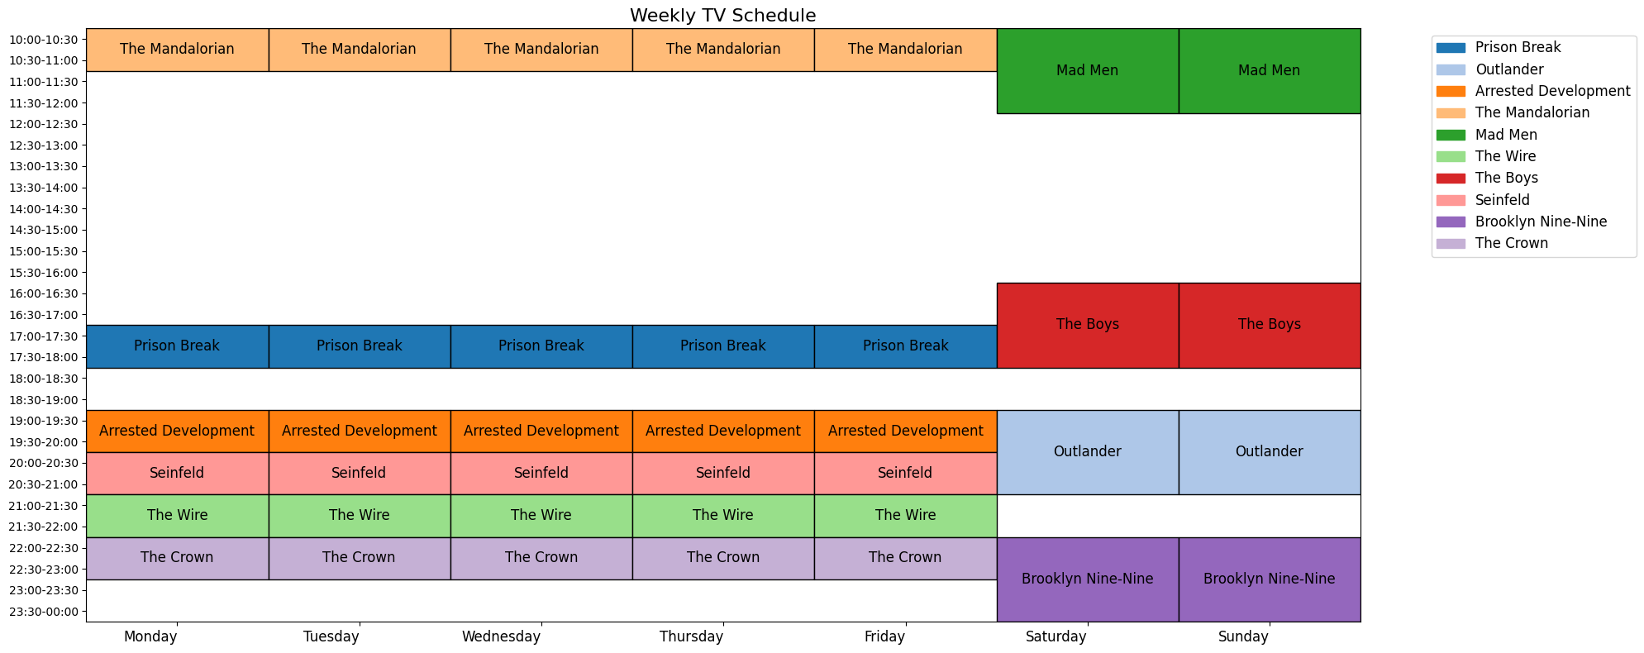
RESULTS

Slide 8
THANK YOU
If you have any questions or would like further discussion, please feel free to contact me.
masknio@gmail.com

